Slide 1

BEST
FRIEND
BY SIGN_IN

Slide 2

PRESENTATION
ON
“BEST FRIEND”
Course Title : Basic Functional English and English Spoken
Course Code : ENG_101
Course Tutor
Ms Khairun Nahar
Lecturer
Department of English

Slide 3
TABLE OF CONTENTS AND MEMBERS
MD. SAZZADUL ISLAM SHAON
MD. MUBARAK HOSSAIN RAZWAN
01
03
MASUD RANA NAYEEM
S M SADMAN AL SIAM
02
04
Student ID: 0242310005101028
Topic: The Beginning
Student ID: 0242310005101027
Topic: The Importance
Student ID: 0242310005101849
Topic : The Difference
Student ID: 0242310005101123
Topic : The Last Chapter

Slide 4
So guys, let’s explore the Friendship journey with me and my teammates!
“THE BEGINNING”
Friendship is not like , you met a random person and now you two are best friends !
It’s like a journey!

Slide 5
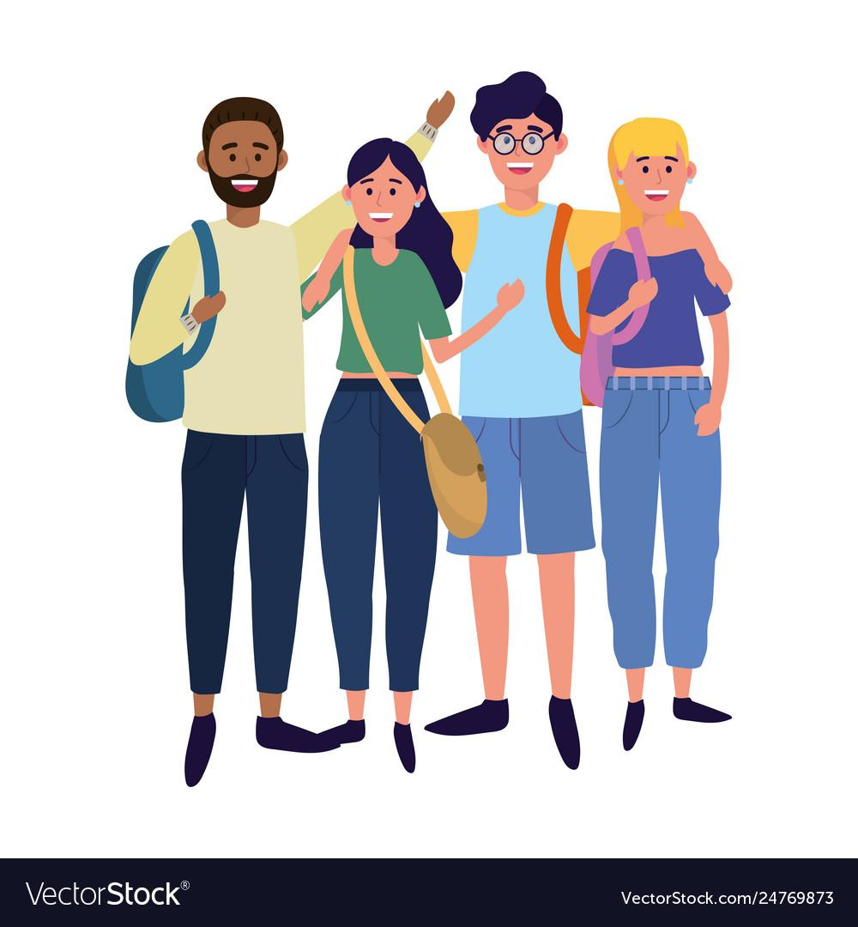
Friendship
Friendship is a supportive relationship between two or more individuals . It based on trust, loyalty and care!
Friend is a person, with whom you feel free!

Slide 6
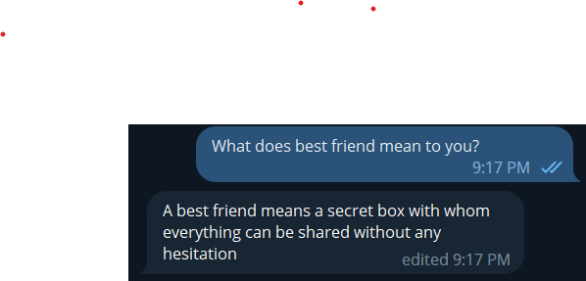
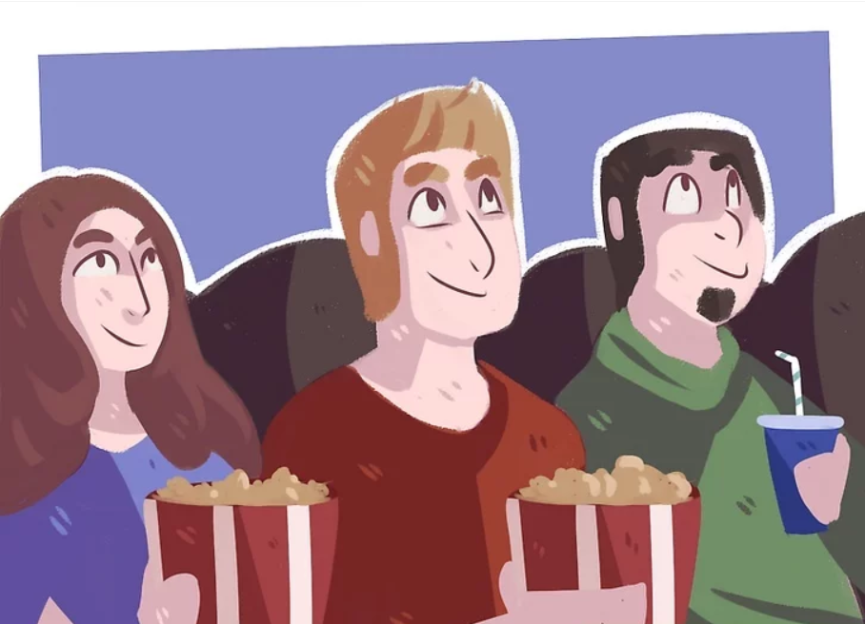
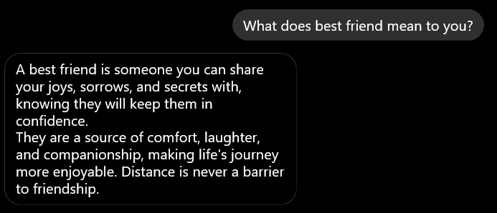
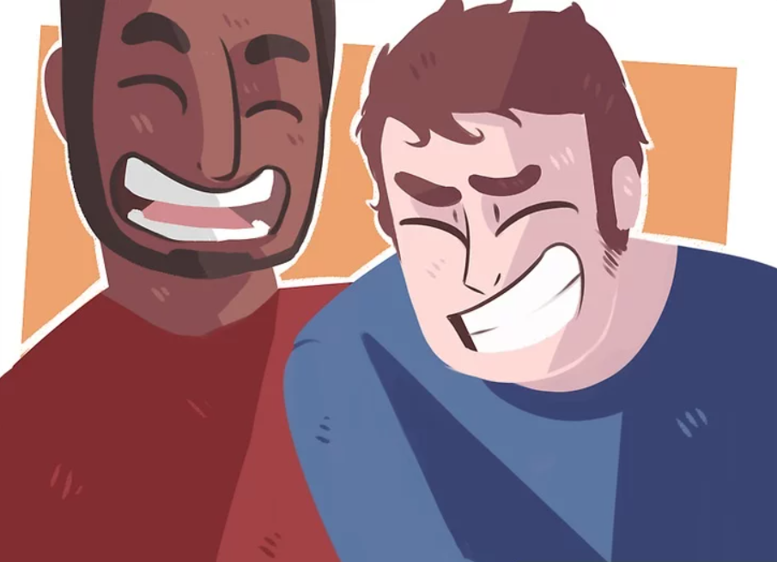
“Best Friend”

Slide 7

Best friend is a person with whom we share a exceptionally close bond , trust, and mutual understanding !

Slide 8



Friends
Best Friend

Slide 9
Difference between Friend and Best Friend
Best friends spent their time together more than friends.
The level of closeness with best friend will be more then a regular friend.
Best friends share their true experiences with each other but friends may not
They will trust more than just a regular friend.
Their communication will more strong than any other simple friend.

Slide 10

Understanding and empathy
Highlight how best friends tend to have a better understanding of each other's emotions and feelings, while friends may not be as in tune with each other's needs.
There are some ways in which understanding and empathy may differ between friends and best friends.
Depth of knowledge
Willingness to listen
Recognition of non-verbal cues
Respect for boundaries
Ability to offer perspective

Slide 11

Support
Compare how best friend are usually more supportive of each other, while friends may not always be as available or willing to help. Sometimes we may get any difficulties in our life or out daily life.A true best friend will be always there for us

Slide 12
The Importance of Having a Best Friend
Emotional support
Honest feedback
Shared experiences
Laughter and fun
Unconditional love

Slide 13


Emotional support: A best friend is someone you can turn to for emotional support when you're feeling down, anxious.
Honest feedback: A best friend will provide honest feedback and constructive criticism when you need it.
Shared experiences: Best friends often share common interests and experiences, which can help strengthen their bond. Whether it's traveling together, going to concerts or movies, or just hanging out, these shared experiences can create lasting memories.

Slide 14


Laughter and fun: A best friend can make you laugh when you need it most. They can be silly and goofy with you, which can help relieve stress and boost your mood.
Unconditional love: A best friend loves you for who you are, faults and all. They accept you without judgment and provide a sense of security and belonging.

Slide 15

THE LAST CHAPTER

Slide 16

3
Major things
Water
Light
Soil

Slide 17



Remain Honest: Honesty is a solid foundation for a healthy friendship based on mutual respect, trust, and emotional intimacy.
Trust: Trust is like an eraser it gets smaller and smaller with every mistake.
Resolve Arguments: you and your friend are having a fight, try to talk to each other and resolve it as soon as you’ve both calmed down.

Slide 18
"Walking with a friend in the dark is better than walking alone in the light."
- Helen Keller
THANK YOU!

Slide 19
ANY QUESTIONS?

